Slide 1
SOA Exam FM
Module 3 – Section 2
Basic Loan Facts

Slide 2










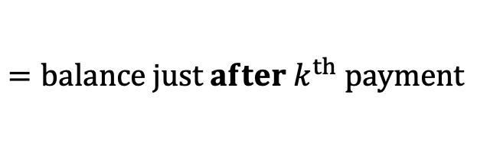
Determining Loan Balances
$$C_{1}$$
$$C_{2}$$
$$⋯$$
$$C_{k}$$
$$C_{k+1}$$
$$⋯$$
$$C_{n}$$
$$L$$
$$=loan amount$$
$$B_{k}$$
$$=balance just after k^{th} payment$$

Slide 3

Determining Loan Balances
$$C_{1}$$
$$C_{2}$$
$$⋯$$
$$C_{k}$$
$$C_{k+1}$$
$$⋯$$
$$C_{n}$$
$$L$$
$$=loan amount$$
$$B_{k}$$
$$=balance just after k^{th} payment$$
$$(Retrospective)$$

Slide 4
Determining Loan Balances
$$C_{1}$$
$$C_{2}$$
$$⋯$$
$$C_{k}$$
$$L$$
$$=loan amount$$
$$B_{k}$$
$$=balance just after k^{th} payment$$
$$(Retrospective)$$

Slide 5
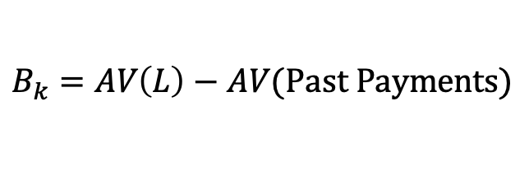
Determining Loan Balances
$$C_{1}$$
$$C_{2}$$
$$⋯$$
$$C_{k}$$
$$L$$
$$=loan amount$$
$$B_{k}$$
$$=balance just after k^{th} payment$$
$$(Retrospective)$$
$$B_{k}=AV\left(L\right)−AV(Past Payments)$$

Slide 6
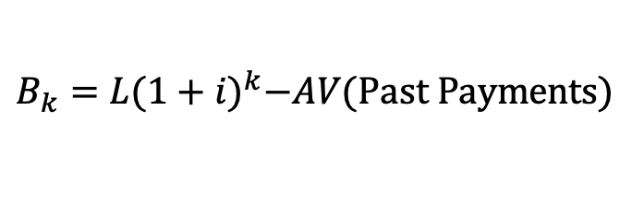
Determining Loan Balances
$$C_{1}$$
$$C_{2}$$
$$⋯$$
$$C_{k}$$
$$L$$
$$=loan amount$$
$$B_{k}$$
$$=balance just after k^{th} payment$$
$$(Retrospective)$$
$$B_{k}=AV\left(L\right)−AV(Past Payments)$$
$$B_{k}=L{(1+i)}^{k}−AV(Past Payments)$$

Slide 7
Determining Loan Balances
$$C_{1}$$
$$C_{2}$$
$$⋯$$
$$C_{k}$$
$$C_{k+1}$$
$$⋯$$
$$C_{n}$$
$$L$$
$$=loan amount$$
$$B_{k}$$
$$=balance just after k^{th} payment$$
$$(Retrospective)$$
$$B_{k}=AV\left(L\right)−AV(Past Payments)$$
$$B_{k}=L{(1+i)}^{k}−AV(Past Payments)$$

Slide 8

Determining Loan Balances
$$C_{1}$$
$$C_{2}$$
$$⋯$$
$$C_{k}$$
$$C_{k+1}$$
$$⋯$$
$$C_{n}$$
$$L$$
$$=loan amount$$
$$B_{k}$$
$$=balance just after k^{th} payment$$
$$(Retrospective)$$
$$B_{k}=AV\left(L\right)−AV(Past Payments)$$
$$B_{k}=L{(1+i)}^{k}−AV(Past Payments)$$
$$(Prospective)$$

Slide 9
Determining Loan Balances
$$C_{k+1}$$
$$⋯$$
$$C_{n}$$
$$L$$
$$=loan amount$$
$$B_{k}$$
$$=balance just after k^{th} payment$$
$$(Retrospective)$$
$$B_{k}=AV\left(L\right)−AV(Past Payments)$$
$$B_{k}=L{(1+i)}^{k}−AV(Past Payments)$$
$$(Prospective)$$

Slide 10
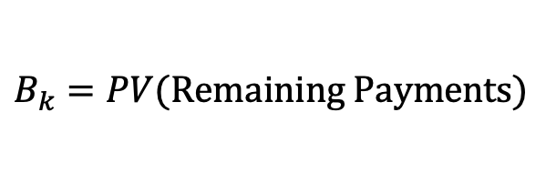
Determining Loan Balances
$$C_{k+1}$$
$$⋯$$
$$C_{n}$$
$$L$$
$$=loan amount$$
$$B_{k}$$
$$=balance just after k^{th} payment$$
$$(Retrospective)$$
$$B_{k}=AV\left(L\right)−AV(Past Payments)$$
$$B_{k}=L{(1+i)}^{k}−AV(Past Payments)$$
$$(Prospective)$$
$$B_{k}=PV(Remaining Payments)$$

Slide 11
Determining Loan Balances
$$C_{1}$$
$$C_{2}$$
$$⋯$$
$$C_{k}$$
$$C_{k+1}$$
$$⋯$$
$$C_{n}$$
$$L$$
$$=loan amount$$
$$B_{k}$$
$$=balance just after k^{th} payment$$
$$(Retrospective)$$
$$B_{k}=AV\left(L\right)−AV(Past Payments)$$
$$B_{k}=L{(1+i)}^{k}−AV(Past Payments)$$
$$(Prospective)$$
$$B_{k}=PV(Remaining Payments)$$

Slide 12

Determining Loan Balances
$$C_{1}$$
$$C_{2}$$
$$⋯$$
$$C_{k}$$
$$C_{k+1}$$
$$⋯$$
$$C_{n}$$
$$L$$
$$=loan amount$$
$$B_{k}$$
$$=balance just after k^{th} payment$$
$$(Retrospective)$$
$$B_{k}=AV\left(L\right)−AV(Past Payments)$$
$$B_{k}=L{(1+i)}^{k}−AV(Past Payments)$$
$$(Prospective)$$
$$B_{k}=PV(Remaining Payments)$$
$$B_{0}=L$$

Slide 13

Determining Loan Balances
$$C_{1}$$
$$C_{2}$$
$$⋯$$
$$C_{k}$$
$$C_{k+1}$$
$$⋯$$
$$C_{n}$$
$$L$$
$$=loan amount$$
$$B_{k}$$
$$=balance just after k^{th} payment$$
$$(Retrospective)$$
$$B_{k}=AV\left(L\right)−AV(Past Payments)$$
$$B_{k}=L{(1+i)}^{k}−AV(Past Payments)$$
$$(Prospective)$$
$$B_{k}=PV(Remaining Payments)$$
$$B_{0}=L$$
$$=PV(Payments)$$

Slide 14
$I_{k}$ and $P_{k}$

Slide 15
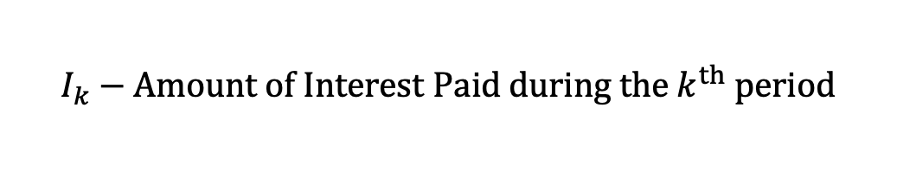
$I_{k}$ and $P_{k}$
$$I_{k}−Amount of Interest Paid during the k^{th} period$$

Slide 16
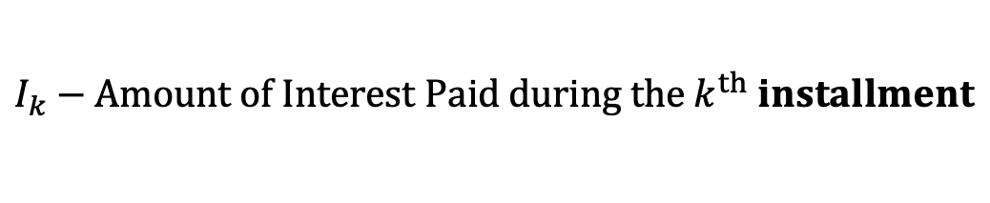
$I_{k}$ and $P_{k}$
$$I_{k}−Amount of Interest Paid during the k^{th} installment$$

Slide 17
$I_{k}$ and $P_{k}$
$$I_{k}−Amount of Interest Paid during the k^{th} period$$

Slide 18

$I_{k}$ and $P_{k}$
$$I_{k}−Amount of Interest Paid during the k^{th} period$$
$$I_{k}=i∙B_{k−1}$$

Slide 19
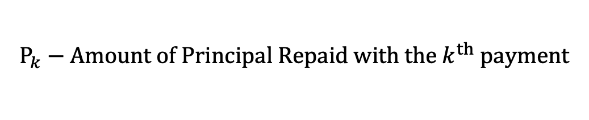
$I_{k}$ and $P_{k}$
$$I_{k}−Amount of Interest Paid during the k^{th} period$$
$$I_{k}=i∙B_{k−1}$$
$$P_{k}−Amount of Principal Repaid with the k^{th} payment$$

Slide 20

$I_{k}$ and $P_{k}$
$$I_{k}−Amount of Interest Paid during the k^{th} period$$
$$I_{k}=i∙B_{k−1}$$
$$P_{k}−Amount of Principal Repaid with the k^{th} payment$$
$$P_{k}=C_{k}−I_{k}$$

Slide 21

$I_{k}$ and $P_{k}$
$$I_{k}−Amount of Interest Paid during the k^{th} period$$
$$I_{k}=i∙B_{k−1}$$
$$P_{k}−Amount of Principal Repaid with the k^{th} payment$$
$$L=\sum_{k=1}^{n}{P_{k}}$$
$$P_{k}=C_{k}−I_{k}$$

Slide 22


Balances at Neighboring Time Periods
$$I_{k}−Amount of Interest Paid during the k^{th} period$$
$$I_{k}=i∙B_{k−1}$$
$$P_{k}−Amount of Principal Repaid with the k^{th} payment$$
$$L=\sum_{k=1}^{n}{P_{k}}$$
$$P_{k}=C_{k}−I_{k}$$
$$B_{k−1}$$
$$B_{k}$$

Slide 23

Balances at Neighboring Time Periods
$$I_{k}−Amount of Interest Paid during the k^{th} period$$
$$I_{k}=i∙B_{k−1}$$
$$P_{k}−Amount of Principal Repaid with the k^{th} payment$$
$$L=\sum_{k=1}^{n}{P_{k}}$$
$$P_{k}=C_{k}−I_{k}$$
$$C_{k}$$
$$B_{k−1}$$
$$B_{k}$$

Slide 24

Balances at Neighboring Time Periods
$$I_{k}−Amount of Interest Paid during the k^{th} period$$
$$I_{k}=i∙B_{k−1}$$
$$P_{k}−Amount of Principal Repaid with the k^{th} payment$$
$$L=\sum_{k=1}^{n}{P_{k}}$$
$$P_{k}=C_{k}−I_{k}$$
$$C_{k}$$
$$B_{k−1}$$
$$B_{k}$$
$$B_{k}=B_{k−1}∙\left(1+i\right)−C_{k}$$

Slide 25

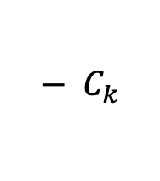

Balances at Neighboring Time Periods
$$I_{k}−Amount of Interest Paid during the k^{th} period$$
$$I_{k}=i∙B_{k−1}$$
$$P_{k}−Amount of Principal Repaid with the k^{th} payment$$
$$L=\sum_{k=1}^{n}{P_{k}}$$
$$P_{k}=C_{k}−I_{k}$$
$$C_{k}$$
$$B_{k−1}$$
$$B_{k}$$
$$B_{k}=B_{k−1}∙\left(1+i\right)−C_{k}$$
$$=B_{k−1}+$$
$$i∙B_{k−1}$$
$${− C}_{k}$$

Slide 26


Balances at Neighboring Time Periods
$$I_{k}−Amount of Interest Paid during the k^{th} period$$
$$I_{k}=i∙B_{k−1}$$
$$P_{k}−Amount of Principal Repaid with the k^{th} payment$$
$$L=\sum_{k=1}^{n}{P_{k}}$$
$$P_{k}=C_{k}−I_{k}$$
$$P_{k}$$
$$I_{k}$$
$$C_{k}$$
$$B_{k−1}$$
$$B_{k}$$
$$B_{k}=B_{k−1}∙\left(1+i\right)−C_{k}$$
$$=B_{k−1}+$$
$$i∙B_{k−1}$$
$${− C}_{k}$$

Slide 27


Balances at Neighboring Time Periods
$$I_{k}−Amount of Interest Paid during the k^{th} period$$
$$I_{k}=i∙B_{k−1}$$
$$P_{k}−Amount of Principal Repaid with the k^{th} payment$$
$$L=\sum_{k=1}^{n}{P_{k}}$$
$$P_{k}=C_{k}−I_{k}$$
$$P_{k}$$
$$I_{k}$$
$$=i∙B_{k−1}$$
$$C_{k}$$
$$B_{k−1}$$
$$B_{k}$$
$$B_{k}=B_{k−1}∙\left(1+i\right)−C_{k}$$
$$=B_{k−1}+$$
$$i∙B_{k−1}$$
$${− C}_{k}$$

Slide 28

Balances at Neighboring Time Periods
$$I_{k}−Amount of Interest Paid during the k^{th} period$$
$$I_{k}=i∙B_{k−1}$$
$$P_{k}−Amount of Principal Repaid with the k^{th} payment$$
$$L=\sum_{k=1}^{n}{P_{k}}$$
$$P_{k}=C_{k}−I_{k}$$
$$P_{k}$$
$$I_{k}$$
$$=i∙B_{k−1}$$
$$C_{k}$$
$$B_{k−1}$$
$$B_{k}$$
$$B_{k}=B_{k−1}∙\left(1+i\right)−C_{k}$$
$$=B_{k−1}+$$
$$I_{k}$$
$${− C}_{k}$$

Slide 29

Balances at Neighboring Time Periods
$$I_{k}−Amount of Interest Paid during the k^{th} period$$
$$I_{k}=i∙B_{k−1}$$
$$P_{k}−Amount of Principal Repaid with the k^{th} payment$$
$$L=\sum_{k=1}^{n}{P_{k}}$$
$$P_{k}=C_{k}−I_{k}$$
$$P_{k}$$
$$I_{k}$$
$$C_{k}$$
$$B_{k−1}$$
$$B_{k}$$
$$B_{k}=B_{k−1}∙\left(1+i\right)−C_{k}$$
$$=B_{k−1}+$$
$$I_{k}$$
$${− C}_{k}$$

Slide 30

Balances at Neighboring Time Periods
$$I_{k}−Amount of Interest Paid during the k^{th} period$$
$$I_{k}=i∙B_{k−1}$$
$$P_{k}−Amount of Principal Repaid with the k^{th} payment$$
$$L=\sum_{k=1}^{n}{P_{k}}$$
$$P_{k}=C_{k}−I_{k}$$
$$P_{k}$$
$$I_{k}$$
$$C_{k}$$
$$=I_{k}+P_{k}$$
$$B_{k−1}$$
$$B_{k}$$
$$B_{k}=B_{k−1}∙\left(1+i\right)−C_{k}$$
$$=B_{k−1}+$$
$$I_{k}$$
$${− C}_{k}$$

Slide 31
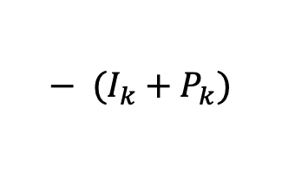
Balances at Neighboring Time Periods
$$I_{k}−Amount of Interest Paid during the k^{th} period$$
$$I_{k}=i∙B_{k−1}$$
$$P_{k}−Amount of Principal Repaid with the k^{th} payment$$
$$L=\sum_{k=1}^{n}{P_{k}}$$
$$P_{k}=C_{k}−I_{k}$$
$$P_{k}$$
$$I_{k}$$
$$C_{k}$$
$$=I_{k}+P_{k}$$
$$B_{k−1}$$
$$B_{k}$$
$$B_{k}=B_{k−1}∙\left(1+i\right)−C_{k}$$
$$=B_{k−1}+$$
$$I_{k}$$
$${− (I_{k}+P}_{k})$$

Slide 32
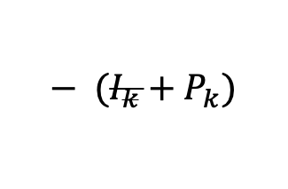

Balances at Neighboring Time Periods
$$I_{k}−Amount of Interest Paid during the k^{th} period$$
$$I_{k}=i∙B_{k−1}$$
$$P_{k}−Amount of Principal Repaid with the k^{th} payment$$
$$L=\sum_{k=1}^{n}{P_{k}}$$
$$P_{k}=C_{k}−I_{k}$$
$$P_{k}$$
$$I_{k}$$
$$C_{k}$$
$$=I_{k}+P_{k}$$
$$B_{k−1}$$
$$B_{k}$$
$$B_{k}=B_{k−1}∙\left(1+i\right)−C_{k}$$
$$=B_{k−1}+$$
$$I_{k}$$
$${− (I_{k}+P}_{k})$$

Slide 33


Balances at Neighboring Time Periods
$$I_{k}−Amount of Interest Paid during the k^{th} period$$
$$I_{k}=i∙B_{k−1}$$
$$P_{k}−Amount of Principal Repaid with the k^{th} payment$$
$$L=\sum_{k=1}^{n}{P_{k}}$$
$$P_{k}=C_{k}−I_{k}$$
$$P_{k}$$
$$I_{k}$$
$$C_{k}$$
$$B_{k−1}$$
$$B_{k}$$
$$B_{k}=B_{k−1}∙\left(1+i\right)−C_{k}$$
$$=B_{k−1}−$$
$$P_{k}$$

Slide 34


Balances at Neighboring Time Periods
$$I_{k}−Amount of Interest Paid during the k^{th} period$$
$$I_{k}=i∙B_{k−1}$$
$$P_{k}−Amount of Principal Repaid with the k^{th} payment$$
$$L=\sum_{k=1}^{n}{P_{k}}$$
$$P_{k}=C_{k}−I_{k}$$
$$P_{k}$$
$$I_{k}$$
$$C_{k}$$
$$B_{k−1}$$
$$B_{k}$$
$$or$$
$$B_{k}=B_{k−1}∙\left(1+i\right)−C_{k}$$
$$B_{k}=B_{k−1}−P_{k}$$

Slide 35
$I_{k}$ and $P_{k}$
$$I_{k}−Amount of Interest Paid during the k^{th} period$$
$$I_{k}=i∙B_{k−1}$$
$$P_{k}−Amount of Principal Repaid with the k^{th} payment$$
$$L=\sum_{k=1}^{n}{P_{k}}$$
$$P_{k}=C_{k}−I_{k}$$

Slide 36
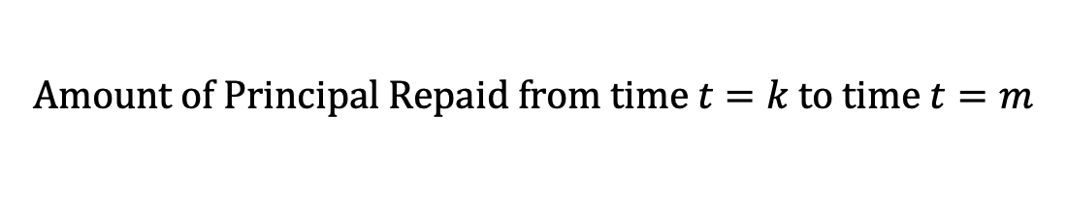
$I_{k}$ and $P_{k}$
$$I_{k}−Amount of Interest Paid during the k^{th} period$$
$$I_{k}=i∙B_{k−1}$$
$$P_{k}−Amount of Principal Repaid with the k^{th} payment$$
$$L=\sum_{k=1}^{n}{P_{k}}$$
$$P_{k}=C_{k}−I_{k}$$
$$Amount of Principal Repaid from time t=k to time t=m$$

Slide 37
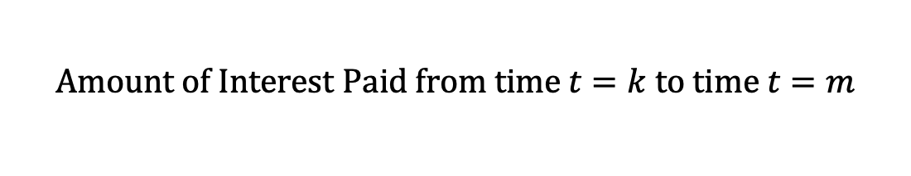
$I_{k}$ and $P_{k}$
$$I_{k}−Amount of Interest Paid during the k^{th} period$$
$$I_{k}=i∙B_{k−1}$$
$$P_{k}−Amount of Principal Repaid with the k^{th} payment$$
$$L=\sum_{k=1}^{n}{P_{k}}$$
$$P_{k}=C_{k}−I_{k}$$
$$Amount of Principal Repaid from time t=k to time t=m$$
$$Amount of Interest Paid from time t=k to time t=m$$

Slide 38






$I_{k}$ and $P_{k}$
$$⋯$$
$$C_{11}$$
$$C_{12}$$
$$C_{13}$$
$$⋯$$
$$B_{10}$$
$$B_{13}$$

Slide 39

$I_{k}$ and $P_{k}$
$$⋯$$
$$C_{11}$$
$$C_{12}$$
$$C_{13}$$
$$⋯$$
$$B_{10}$$
$$=1000$$
$$B_{13}$$

Slide 40



$I_{k}$ and $P_{k}$
$$⋯$$
$$C_{11}=120$$
$$C_{12}=130$$
$$C_{13}=140$$
$$⋯$$
$$B_{10}$$
$$=1000$$
$$B_{13}$$

Slide 41

$I_{k}$ and $P_{k}$
$$I_{11}=100$$
$$⋯$$
$$C_{11}=120$$
$$C_{12}=130$$
$$C_{13}=140$$
$$⋯$$
$$B_{10}$$
$$=1000$$
$$B_{13}$$

Slide 42

$I_{k}$ and $P_{k}$
$$P_{11}=20$$
$$I_{11}=100$$
$$⋯$$
$$C_{11}=120$$
$$C_{12}=130$$
$$C_{13}=140$$
$$⋯$$
$$B_{10}$$
$$=1000$$
$$B_{13}$$

Slide 43

$I_{k}$ and $P_{k}$
$$P_{11}=20$$
$$I_{11}=100$$
$$I_{12}=95$$
$$⋯$$
$$C_{11}=120$$
$$C_{12}=130$$
$$C_{13}=140$$
$$⋯$$
$$B_{10}$$
$$=1000$$
$$B_{13}$$

Slide 44

$I_{k}$ and $P_{k}$
$$P_{11}=20$$
$$P_{12}=35$$
$$I_{11}=100$$
$$I_{12}=95$$
$$⋯$$
$$C_{11}=120$$
$$C_{12}=130$$
$$C_{13}=140$$
$$⋯$$
$$B_{10}$$
$$=1000$$
$$B_{13}$$

Slide 45

$I_{k}$ and $P_{k}$
$$P_{11}=20$$
$$P_{12}=35$$
$$I_{11}=100$$
$$I_{12}=95$$
$$I_{13}=90$$
$$⋯$$
$$C_{11}=120$$
$$C_{12}=130$$
$$C_{13}=140$$
$$⋯$$
$$B_{10}$$
$$=1000$$
$$B_{13}$$

Slide 46

$I_{k}$ and $P_{k}$
$$P_{11}=20$$
$$P_{12}=35$$
$$P_{13}=50$$
$$I_{11}=100$$
$$I_{12}=95$$
$$I_{13}=90$$
$$⋯$$
$$C_{11}=120$$
$$C_{12}=130$$
$$C_{13}=140$$
$$⋯$$
$$B_{10}$$
$$=1000$$
$$B_{13}$$

Slide 47



$I_{k}$ and $P_{k}$
$$P_{11}=20$$
$$P_{12}=35$$
$$P_{13}=50$$
$$I_{11}=100$$
$$I_{12}=95$$
$$I_{13}=90$$
$$⋯$$
$$C_{11}=120$$
$$C_{12}=130$$
$$C_{13}=140$$
$$⋯$$
$$B_{10}$$
$$=1000$$
$$B_{13}$$

Slide 48

$I_{k}$ and $P_{k}$
$$P_{11}=20$$
$$P_{12}=35$$
$$P_{13}=50$$
$$I_{11}=100$$
$$I_{12}=95$$
$$I_{13}=90$$
$$⋯$$
$$C_{11}=120$$
$$C_{12}=130$$
$$C_{13}=140$$
$$⋯$$
$$B_{10}$$
$$=1000$$
$$B_{13}$$
$$B_{11}=980$$

Slide 49

$I_{k}$ and $P_{k}$
$$P_{11}=20$$
$$P_{12}=35$$
$$P_{13}=50$$
$$I_{11}=100$$
$$I_{12}=95$$
$$I_{13}=90$$
$$⋯$$
$$C_{11}=120$$
$$C_{12}=130$$
$$C_{13}=140$$
$$⋯$$
$$B_{10}$$
$$=1000$$
$$B_{13}$$
$$B_{11}=980$$
$$B_{12}=945$$

Slide 50

$I_{k}$ and $P_{k}$
$$P_{11}=20$$
$$P_{12}=35$$
$$P_{13}=50$$
$$I_{11}=100$$
$$I_{12}=95$$
$$I_{13}=90$$
$$⋯$$
$$C_{11}=120$$
$$C_{12}=130$$
$$C_{13}=140$$
$$⋯$$
$$B_{10}$$
$$=1000$$
$$B_{13}$$
$$=895$$
$$B_{11}=980$$
$$B_{12}=945$$

Slide 51
$I_{k}$ and $P_{k}$
$$P_{11}=20$$
$$P_{12}=35$$
$$P_{13}=50$$
$$I_{11}=100$$
$$I_{12}=95$$
$$I_{13}=90$$
$$⋯$$
$$C_{11}=120$$
$$C_{12}=130$$
$$C_{13}=140$$
$$⋯$$
$$B_{10}$$
$$=1000$$
$$B_{13}$$
$$=895$$

Slide 52
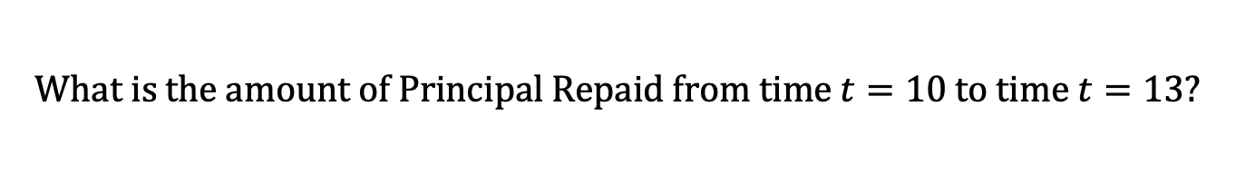
$I_{k}$ and $P_{k}$
$$P_{11}=20$$
$$P_{12}=35$$
$$P_{13}=50$$
$$I_{11}=100$$
$$I_{12}=95$$
$$I_{13}=90$$
$$⋯$$
$$C_{11}=120$$
$$C_{12}=130$$
$$C_{13}=140$$
$$⋯$$
$$B_{10}$$
$$=1000$$
$$B_{13}$$
$$=895$$
$$What is the amount of Principal Repaid from time t=10 to time t=13?$$

Slide 53


$I_{k}$ and $P_{k}$
$$P_{11}=20$$
$$P_{12}=35$$
$$P_{13}=50$$
$$I_{11}=100$$
$$I_{12}=95$$
$$I_{13}=90$$
$$⋯$$
$$C_{11}=120$$
$$C_{12}=130$$
$$C_{13}=140$$
$$⋯$$
$$B_{10}$$
$$=1000$$
$$B_{13}$$
$$=895$$
$$What is the amount of Principal Repaid from time t=10 to time t=13?$$
$$Answer:$$
$$20+35+50=105$$

Slide 54



$I_{k}$ and $P_{k}$
$$P_{11}=20$$
$$P_{12}=35$$
$$P_{13}=50$$
$$I_{11}=100$$
$$I_{12}=95$$
$$I_{13}=90$$
$$⋯$$
$$C_{11}=120$$
$$C_{12}=130$$
$$C_{13}=140$$
$$⋯$$
$$B_{10}$$
$$=1000$$
$$B_{13}$$
$$=895$$
$$What is the amount of Principal Repaid from time t=10 to time t=13?$$
$$Answer:$$
$$20+35+50=105$$
$$or$$
$$1000−895=105$$

Slide 55

$I_{k}$ and $P_{k}$
$$P_{11}=20$$
$$P_{12}=35$$
$$P_{13}=50$$
$$I_{11}=100$$
$$I_{12}=95$$
$$I_{13}=90$$
$$⋯$$
$$C_{11}=120$$
$$C_{12}=130$$
$$C_{13}=140$$
$$⋯$$
$$B_{10}$$
$$=1000$$
$$B_{13}$$
$$=895$$
$$What is the amount of Principal Repaid from time t=10 to time t=13?$$
$$Answer:$$
$$20+35+50=105$$
$$or$$
$$1000−895=105$$
$$\sum_{j=11}^{13}{P_{j}}$$

Slide 56

$I_{k}$ and $P_{k}$
$$P_{11}=20$$
$$P_{12}=35$$
$$P_{13}=50$$
$$I_{11}=100$$
$$I_{12}=95$$
$$I_{13}=90$$
$$⋯$$
$$C_{11}=120$$
$$C_{12}=130$$
$$C_{13}=140$$
$$⋯$$
$$B_{10}$$
$$=1000$$
$$B_{13}$$
$$=895$$
$$What is the amount of Principal Repaid from time t=10 to time t=13?$$
$$Answer:$$
$$20+35+50=105$$
$$or$$
$$1000−895=105$$
$$\sum_{j=11}^{13}{P_{j}}$$
$$=B_{10}−B_{13}$$

Slide 57
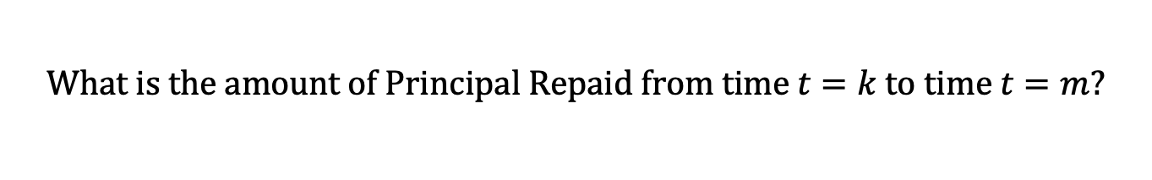
$I_{k}$ and $P_{k}$
$$P_{11}=20$$
$$P_{12}=35$$
$$P_{13}=50$$
$$I_{11}=100$$
$$I_{12}=95$$
$$I_{13}=90$$
$$⋯$$
$$C_{11}=120$$
$$C_{12}=130$$
$$C_{13}=140$$
$$⋯$$
$$B_{10}$$
$$=1000$$
$$B_{13}$$
$$=895$$
$$What is the amount of Principal Repaid from time t=k to time t=m?$$
$$Answer:$$

Slide 58

$I_{k}$ and $P_{k}$
$$P_{11}=20$$
$$P_{12}=35$$
$$P_{13}=50$$
$$I_{11}=100$$
$$I_{12}=95$$
$$I_{13}=90$$
$$⋯$$
$$C_{11}=120$$
$$C_{12}=130$$
$$C_{13}=140$$
$$⋯$$
$$B_{10}$$
$$=1000$$
$$B_{13}$$
$$=895$$
$$What is the amount of Principal Repaid from time t=k to time t=m?$$
$$Answer:$$
$$\sum_{j=k+1}^{m}{P_{j}}$$

Slide 59

$I_{k}$ and $P_{k}$
$$P_{11}=20$$
$$P_{12}=35$$
$$P_{13}=50$$
$$I_{11}=100$$
$$I_{12}=95$$
$$I_{13}=90$$
$$⋯$$
$$C_{11}=120$$
$$C_{12}=130$$
$$C_{13}=140$$
$$⋯$$
$$B_{10}$$
$$=1000$$
$$B_{13}$$
$$=895$$
$$What is the amount of Principal Repaid from time t=k to time t=m?$$
$$Answer:$$
$$\sum_{j=k+1}^{m}{P_{j}}$$
$$=B_{k}−B_{m}$$

Slide 60
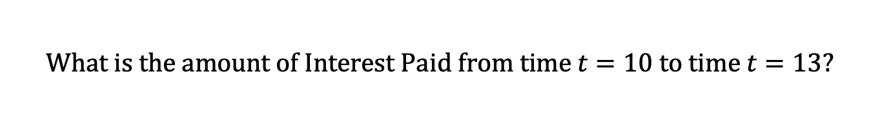
$I_{k}$ and $P_{k}$
$$P_{11}=20$$
$$P_{12}=35$$
$$P_{13}=50$$
$$I_{11}=100$$
$$I_{12}=95$$
$$I_{13}=90$$
$$⋯$$
$$C_{11}=120$$
$$C_{12}=130$$
$$C_{13}=140$$
$$⋯$$
$$B_{10}$$
$$=1000$$
$$B_{13}$$
$$=895$$
$$What is the amount of Interest Paid from time t=10 to time t=13?$$

Slide 61





$I_{k}$ and $P_{k}$
$$P_{11}=20$$
$$P_{12}=35$$
$$P_{13}=50$$
$$I_{11}=100$$
$$I_{12}=95$$
$$I_{13}=90$$
$$⋯$$
$$C_{11}=120$$
$$C_{12}=130$$
$$C_{13}=140$$
$$⋯$$
$$B_{10}$$
$$=1000$$
$$B_{13}$$
$$=895$$
$$What is the amount of Interest Paid from time t=10 to time t=13?$$
$$Answer:$$
$$100+95+90=285$$

Slide 62
$I_{k}$ and $P_{k}$
$$P_{11}=20$$
$$P_{12}=35$$
$$P_{13}=50$$
$$I_{11}=100$$
$$I_{12}=95$$
$$I_{13}=90$$
$$⋯$$
$$C_{11}=120$$
$$C_{12}=130$$
$$C_{13}=140$$
$$⋯$$
$$B_{10}$$
$$=1000$$
$$B_{13}$$
$$=895$$
$$What is the amount of Interest Paid from time t=10 to time t=13?$$
$$Answer:$$
$$100+95+90=285$$
$$or$$
$$\left(120+130+140\right)−(20+35+50)=285$$

Slide 63
$I_{k}$ and $P_{k}$
$$P_{11}=20$$
$$P_{12}=35$$
$$P_{13}=50$$
$$I_{11}=100$$
$$I_{12}=95$$
$$I_{13}=90$$
$$⋯$$
$$C_{11}=120$$
$$C_{12}=130$$
$$C_{13}=140$$
$$⋯$$
$$B_{10}$$
$$=1000$$
$$B_{13}$$
$$=895$$
$$What is the amount of Interest Paid from time t=10 to time t=13?$$
$$Answer:$$
$$100+95+90=285$$
$$or$$
$$\left(120+130+140\right)−(20+35+50)=285$$

Slide 64
$I_{k}$ and $P_{k}$
$$P_{11}=20$$
$$P_{12}=35$$
$$P_{13}=50$$
$$I_{11}=100$$
$$I_{12}=95$$
$$I_{13}=90$$
$$⋯$$
$$C_{11}=120$$
$$C_{12}=130$$
$$C_{13}=140$$
$$⋯$$
$$B_{10}$$
$$=1000$$
$$B_{13}$$
$$=895$$
$$What is the amount of Interest Paid from time t=10 to time t=13?$$
$$Answer:$$
$$100+95+90=285$$
$$or$$
$$\left(120+130+140\right)−(20+35+50)=285$$
$$\left(120+130+140\right)−(1000−895)=285$$

Slide 65

$I_{k}$ and $P_{k}$
$$P_{11}=20$$
$$P_{12}=35$$
$$P_{13}=50$$
$$I_{11}=100$$
$$I_{12}=95$$
$$I_{13}=90$$
$$⋯$$
$$C_{11}=120$$
$$C_{12}=130$$
$$C_{13}=140$$
$$⋯$$
$$B_{10}$$
$$=1000$$
$$B_{13}$$
$$=895$$
$$What is the amount of Interest Paid from time t=10 to time t=13?$$
$$Answer:$$
$$100+95+90=285$$
$$or$$
$$\left(120+130+140\right)−(20+35+50)=285$$
$$\left(120+130+140\right)−(1000−895)=285$$
$$\sum_{j=11}^{13}{I_{j}}$$

Slide 66


$I_{k}$ and $P_{k}$
$$P_{11}=20$$
$$P_{12}=35$$
$$P_{13}=50$$
$$I_{11}=100$$
$$I_{12}=95$$
$$I_{13}=90$$
$$⋯$$
$$C_{11}=120$$
$$C_{12}=130$$
$$C_{13}=140$$
$$⋯$$
$$B_{10}$$
$$=1000$$
$$B_{13}$$
$$=895$$
$$What is the amount of Interest Paid from time t=10 to time t=13?$$
$$Answer:$$
$$100+95+90=285$$
$$or$$
$$\left(120+130+140\right)−(20+35+50)=285$$
$$\left(120+130+140\right)−(1000−895)=285$$
$$\sum_{j=11}^{13}{I_{j}}$$
$$=\sum_{j=11}^{13}{C_{j}}−$$
$$\sum_{j=11}^{13}{P_{j}}$$

Slide 67

$I_{k}$ and $P_{k}$
$$P_{11}=20$$
$$P_{12}=35$$
$$P_{13}=50$$
$$I_{11}=100$$
$$I_{12}=95$$
$$I_{13}=90$$
$$⋯$$
$$C_{11}=120$$
$$C_{12}=130$$
$$C_{13}=140$$
$$⋯$$
$$B_{10}$$
$$=1000$$
$$B_{13}$$
$$=895$$
$$What is the amount of Interest Paid from time t=10 to time t=13?$$
$$Answer:$$
$$100+95+90=285$$
$$or$$
$$\left(120+130+140\right)−(20+35+50)=285$$
$$\left(120+130+140\right)−(1000−895)=285$$
$$\sum_{j=11}^{13}{I_{j}}$$
$$=\sum_{j=11}^{13}{C_{j}}−$$
$$(B_{10}−B_{13})$$

Slide 68
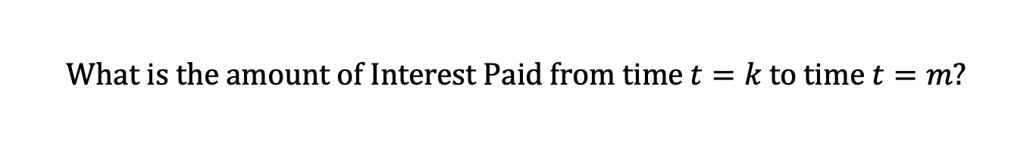
$I_{k}$ and $P_{k}$
$$P_{11}=20$$
$$P_{12}=35$$
$$P_{13}=50$$
$$I_{11}=100$$
$$I_{12}=95$$
$$I_{13}=90$$
$$⋯$$
$$C_{11}=120$$
$$C_{12}=130$$
$$C_{13}=140$$
$$⋯$$
$$B_{10}$$
$$=1000$$
$$B_{13}$$
$$=895$$
$$What is the amount of Interest Paid from time t=k to time t=m?$$
$$Answer:$$

Slide 69



$I_{k}$ and $P_{k}$
$$P_{11}=20$$
$$P_{12}=35$$
$$P_{13}=50$$
$$I_{11}=100$$
$$I_{12}=95$$
$$I_{13}=90$$
$$⋯$$
$$C_{11}=120$$
$$C_{12}=130$$
$$C_{13}=140$$
$$⋯$$
$$B_{10}$$
$$=1000$$
$$B_{13}$$
$$=895$$
$$What is the amount of Interest Paid from time t=k to time t=m?$$
$$Answer:$$
$$\sum_{j=k+1}^{m}{I_{j}}$$
$$=\sum_{j=k+1}^{m}{C_{j}} −$$
$$(B_{k}−B_{m})$$

Slide 70
$I_{k}$ and $P_{k}$
$$I_{k}−Amount of Interest Paid during the k^{th} period$$
$$I_{k}=i∙B_{k−1}$$
$$P_{k}−Amount of Principal Repaid with the k^{th} payment$$
$$L=\sum_{k=1}^{n}{P_{k}}$$
$$P_{k}=C_{k}−I_{k}$$
$$Amount of Principal Repaid from time t=k to time t=m$$

Slide 71


$I_{k}$ and $P_{k}$
$$I_{k}−Amount of Interest Paid during the k^{th} period$$
$$I_{k}=i∙B_{k−1}$$
$$P_{k}−Amount of Principal Repaid with the k^{th} payment$$
$$L=\sum_{k=1}^{n}{P_{k}}$$
$$P_{k}=C_{k}−I_{k}$$
$$Amount of Principal Repaid from time t=k to time t=m$$
$$\sum_{j=k+1}^{m}{P_{j}}$$
$$=B_{k}−B_{m}$$

Slide 72
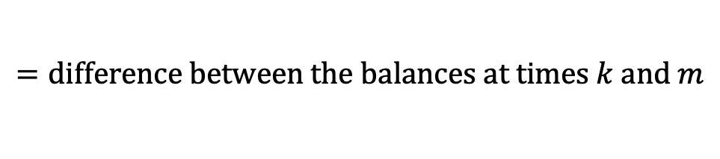
$I_{k}$ and $P_{k}$
$$I_{k}−Amount of Interest Paid during the k^{th} period$$
$$I_{k}=i∙B_{k−1}$$
$$P_{k}−Amount of Principal Repaid with the k^{th} payment$$
$$L=\sum_{k=1}^{n}{P_{k}}$$
$$P_{k}=C_{k}−I_{k}$$
$$Amount of Principal Repaid from time t=k to time t=m$$
$$\sum_{j=k+1}^{m}{P_{j}}$$
$$=B_{k}−B_{m}$$
$$=difference between the balances at times k and m$$

Slide 73
$I_{k}$ and $P_{k}$
$$I_{k}−Amount of Interest Paid during the k^{th} period$$
$$I_{k}=i∙B_{k−1}$$
$$P_{k}−Amount of Principal Repaid with the k^{th} payment$$
$$L=\sum_{k=1}^{n}{P_{k}}$$
$$P_{k}=C_{k}−I_{k}$$
$$Amount of Principal Repaid from time t=k to time t=m$$
$$\sum_{j=k+1}^{m}{P_{j}}$$
$$=B_{k}−B_{m}$$
$$=difference between the balances at times k and m$$
$$Amount of Interest Paid from time t=k to time t=m$$

Slide 74



$I_{k}$ and $P_{k}$
$$I_{k}−Amount of Interest Paid during the k^{th} period$$
$$I_{k}=i∙B_{k−1}$$
$$P_{k}−Amount of Principal Repaid with the k^{th} payment$$
$$L=\sum_{k=1}^{n}{P_{k}}$$
$$P_{k}=C_{k}−I_{k}$$
$$Amount of Principal Repaid from time t=k to time t=m$$
$$\sum_{j=k+1}^{m}{P_{j}}$$
$$=B_{k}−B_{m}$$
$$=difference between the balances at times k and m$$
$$Amount of Interest Paid from time t=k to time t=m$$
$$\sum_{j=k+1}^{m}{I_{j}}$$
$$=\sum_{j=k+1}^{m}{C_{j}} −$$
$$\sum_{j=k+1}^{m}{P_{j}}$$

Slide 75

$I_{k}$ and $P_{k}$
$$I_{k}−Amount of Interest Paid during the k^{th} period$$
$$I_{k}=i∙B_{k−1}$$
$$P_{k}−Amount of Principal Repaid with the k^{th} payment$$
$$L=\sum_{k=1}^{n}{P_{k}}$$
$$P_{k}=C_{k}−I_{k}$$
$$Amount of Principal Repaid from time t=k to time t=m$$
$$\sum_{j=k+1}^{m}{P_{j}}$$
$$=B_{k}−B_{m}$$
$$=difference between the balances at times k and m$$
$$Amount of Interest Paid from time t=k to time t=m$$
$$\sum_{j=k+1}^{m}{I_{j}}$$
$$=\sum_{j=k+1}^{m}{C_{j}} −$$
$$(B_{k}−B_{m})$$

Slide 76
$I_{k}$ and $P_{k}$
$$I_{k}−Amount of Interest Paid during the k^{th} period$$
$$I_{k}=i∙B_{k−1}$$
$$P_{k}−Amount of Principal Repaid with the k^{th} payment$$
$$L=\sum_{k=1}^{n}{P_{k}}$$
$$P_{k}=C_{k}−I_{k}$$
$$Amount of Principal Repaid from time t=k to time t=m$$
$$\sum_{j=k+1}^{m}{P_{j}}$$
$$=B_{k}−B_{m}$$
$$=difference between the balances at times k and m$$
$$Amount of Interest Paid from time t=k to time t=m$$
$$\sum_{j=k+1}^{m}{I_{j}}$$
$$=\sum_{j=k+1}^{m}{C_{j}} −$$
$$=\left(\begin{aligned}the sum of the payments after time k \\ up to and including time m\end{aligned}\right)$$
$$(B_{k}−B_{m})$$
$$−\left(\begin{aligned}the amount of principal repaid \\ from time k to time m\end{aligned}\right)$$

